Slide 1
Using Machine Learning Methods to Indentify Human Activity
An accerelometer and gyroscope in a smart phone were used to aquire the used data.

Slide 2
Background
With the advent of nano technologies, many sensors can now be embedded into phones and other wearables, (Damini et al, 2022).
Among which are accelerometers, gyroscopes and heart rate monitors.
In this study an accelerometer was used with a gyroscope to measure acceleration and angular velocity respectively.
These measurements are in the x,y and z directions.
The data used in this study was collected using a samsung galaxy 2 smart phone strapped in the waist, (Anguita et al, 2012) at the the University of Genova in a controlled enviroment.

Slide 3
Human Activity Recognition Methods
Some of the available methods that are used to identify human activity include among others usage of sensors used to measure motion.
And other methods used include among others usage of still images and video.
In this study as mentioned earlier movement was measured using sensors to measure motion in the x,y and z directions.

Slide 4
The aims
Do an exploratory data analysis of the dataset and also identify the included activities.
Use different machine learning algorithms in the modeling process of indentifying the given activities.
Aquire the prediction scores of the different classifiers, with the their respective cross validation values.
Compare the results among classifiers.

Slide 5
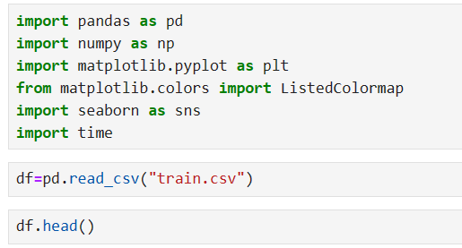
Exploratory Data Analysis. (EDA)
The dataset was split into 70% taking the training set and 30% taking the testing set respectively.
30 Individuals were used in the exercise.
The number of features in the dataset are 561.
Pandas and other python libraries were used in the task.

Slide 6
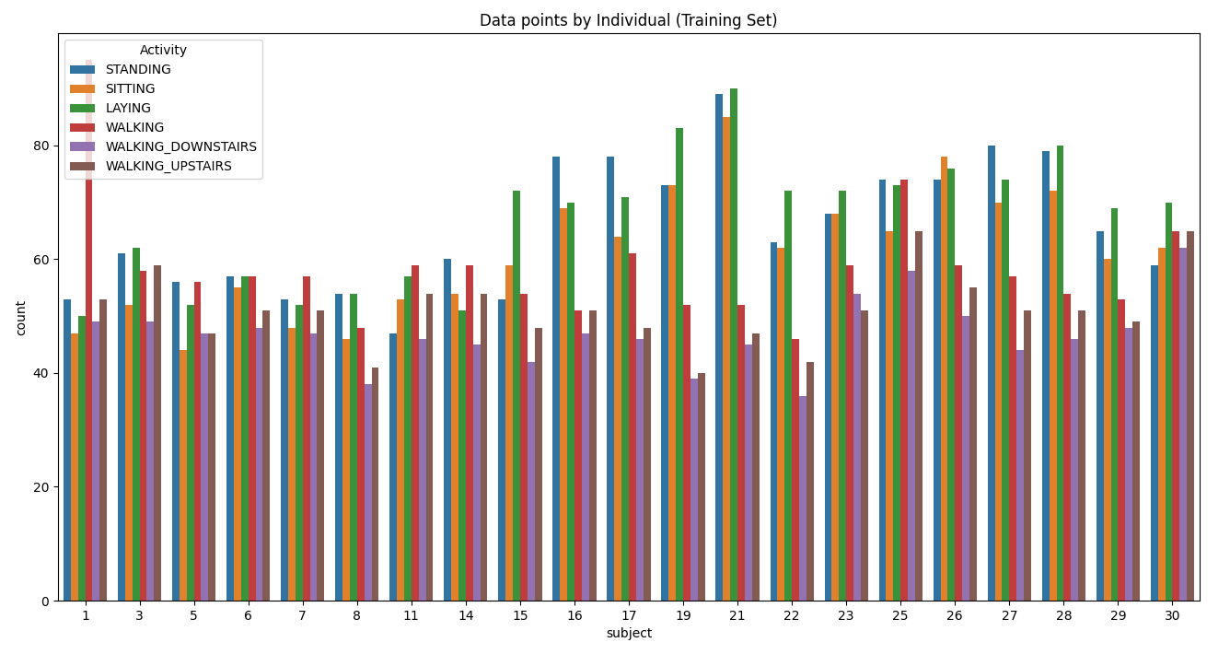
Exploratory Data Analysis. (EDA)
Data points by each of the individuals in the training set. We can infer that the dataset is balanced.

Slide 7
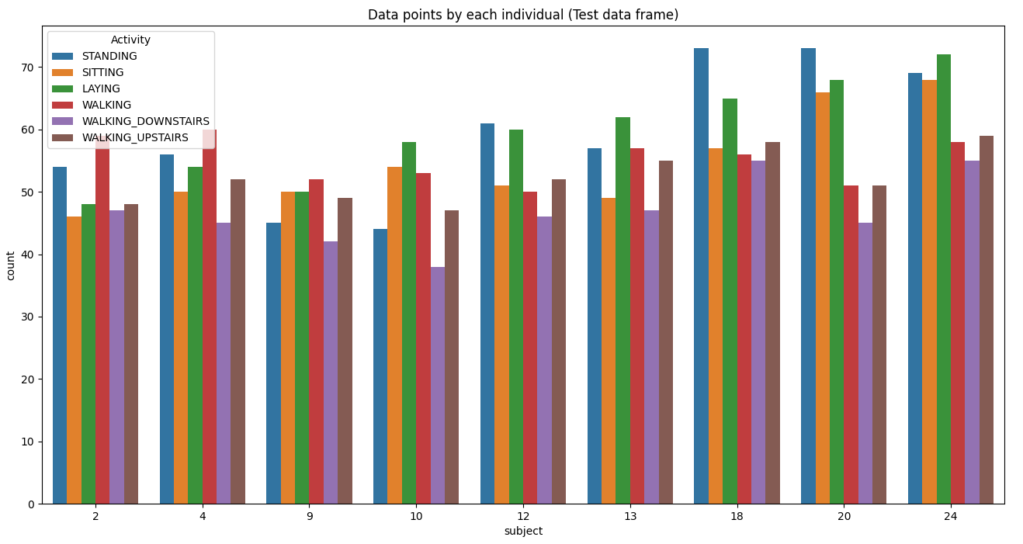
Exploratory Data Analysis. (EDA)
The same is true with the testing set.

Slide 8
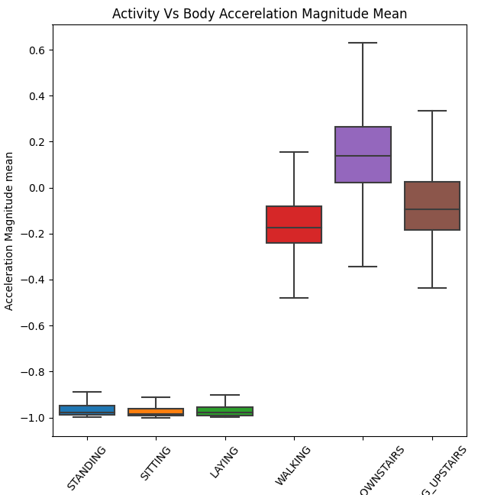
Exploratory Data Analysis. (EDA)
Body Acceleration plot for each of the activities.

Slide 9
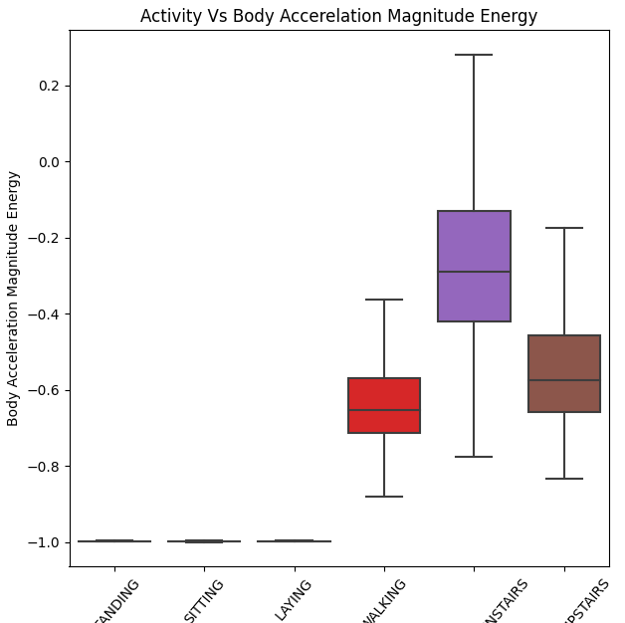
Exploratory Data Analysis. (EDA)
Body acceleration magnitude plot for energy.

Slide 10
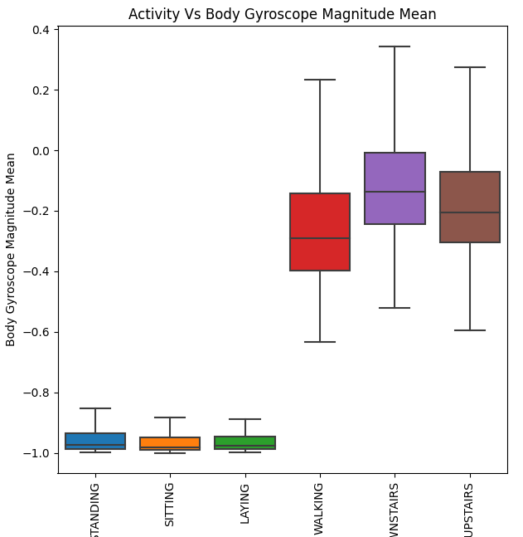
Exploratory Data Analysis. (EDA)
This box plot shows the gyroscope magnitude mean.

Slide 11
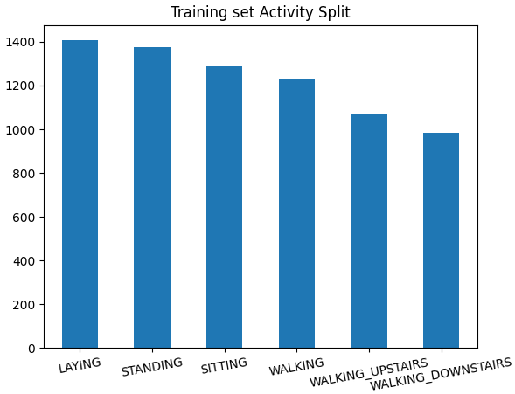
Exploratory Data Analysis. (EDA)
Count plot for all the activities.

Slide 12
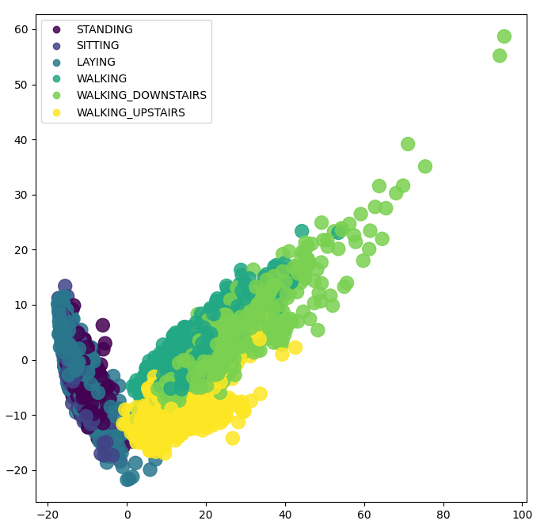
Exploratory Data Analysis. (EDA)
Dimensionality reduction for the key components.

Slide 13
Modeling
In the modeling of the problem 4 supervised machine learning algorithms were used.
These are,
XgboostClassifier.
Random Forest Classifier.
Support Vector Machines.
Decision Tree Classifier.

Slide 14
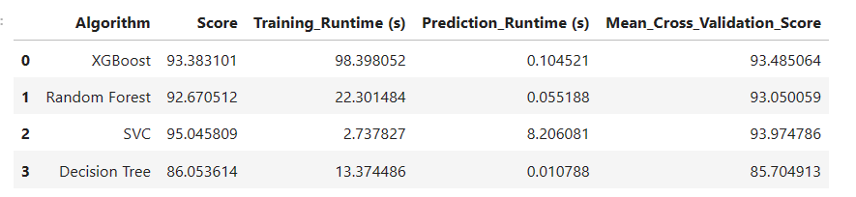
The results

